Slide 1
CapsicoHealth
Tilda Programming Model Tutorial

Slide 2
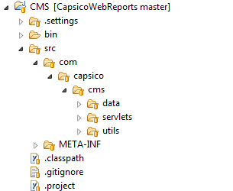
Basic structure of a Java project
We’ll create a basic project for the code
A “data” folder to host the Tilda artifacts
A “servlets” folder for servlets
A “utils” or “helpers” folder to hold other artifacts

Slide 3
Data Model
We’ll create a very basic object for the purpose of this tutorial, a simple table that represents claims for a patient.
DummyData
refnum (PK)
patientId
diseaseName
state
cost
dateOfService
descr
created
lastUpdated
deleted
Index: diseaseName, state order by dateOfService
Index: diseaseName, dateOfService order by state

Slide 4
Tilda JSON definition file
Tilda objects are defined through a Tilda JSON file where entities are defined.
Here, we’ll have the file
/CMS/src/com/capsico/cms/data/_tilda.cms.json
In there, we’ll define a dummy object matching the table design we did previously.
{ "name": "DummyData"
,"description": "Dummy data for sample app"
,"columns":[
{ "name": "patientId" , "type":"STRING" , "nullable":false, "size": 20, "description":"blah" },
{ "name": "diseaseName" , "type":"STRING" , "nullable":false, "size": 10, "description":"blah" },
{ "name": "state" , "type":"STRING" , "nullable":false, "size": 2, "description":"blah" },
{ "name": "cost" , "type":"FLOAT" , "nullable":false, "description":"blah" },
{ "name": "dateOfService" , "type":"DATETIME", "nullable":false, "description":"blah" },
{ "name": "descr" , "type":"STRING" , "nullable":true , "size": 1024, "description":"blah" },
]
,"primary": { "autogen":true, "keyBatch":2500 }
,"foreign": [
]
,"indices":[
{ "name":"DiseaseState" , "columns":["diseaseName", "state"] , "orderBy":["dateOfService desc"] }
]
,"json":[
{ "name":"", "columns":["refnum", "patientId", "diseaseName", "state", "cost", "dateOfService", "descr", "created", "lastUpdated"] }
]
},

Slide 5
Tilda object (1)
Columns
Type: STRING (with requires ‘size’ attribute), CHAR, INTEGER, LONG, FLOAT, DOUBLE, BOOLEAN, DATETIME, BINARY, BITFIELD
DATETIME fields are managed by Tilda to provide built-in time zone support. Contrary to other types, fields declared as DATETIME result in 2 columns in the DB, one to store the timestamp and offset, and the other to store the timezone (most databases do not support a full time-zoned timestamp, so this is required).
Nullable: false by default.
Size: required for columns of type STRING. Tilda automatically creates a char, varchar, or text field based on the size specified.
For example, on Postgres, size < 15 ? Char : size < 4096 ? varchar : text
All Tilda objects have an additional 3 fields created for managing a row’s life cycle. They are “created”, “lastUpdated”, and “deleted” as plain timestamps.
Primary
Either custom by specifying “cols”:[“col1”, “col2”… ]
Or automatic by specifying “autogen”: true and optionally, “keyBatch”: 1000
KEY table
Tilda maintains automatic keys through the TILDA.KEY table. When the application creates a new object that required a key (“autogen”:true), Tilda reserves a set of keys (as per “keyBatch”) to dispatch to the application.
For objects that you expect to create lots of instances of, a larger “keyBatch” would avoid going back to the DB too often, but too large a number can create “holes” in keys number each time the server would restart.

Slide 6
Tilda object (2)
Foreign
{ "name": "User", "srcColumns":["creatorRefnum"], "destObject": "com.capsico.people.data.People.Person" }
Give a “name“, list the source columns, and declare the destination object.
Objects are referred to with their full class path + schema + name.
Indices
Declare unique or regular indices
“name” is the name of the index
“columns” is a list of columns
“orderBy” is another list of columns to provide result set ordering
If “orderBy” is not specified, a unique index will be created
“db” is true by default but you can define an index at the application level only that wouldn’t translate into an index in the database.
Json
Declares an adapter to serialize an object to JSON
You can create multiple serializers. This is useful for example if you create a UI where you show a list of objects, and maybe you only need a few columns, Vs. a UI where you’d see the full details of an object and would need all columns.
“name”: the name of the JSON serializer
“columns”: the list of columns that are part of the serializer

Slide 7
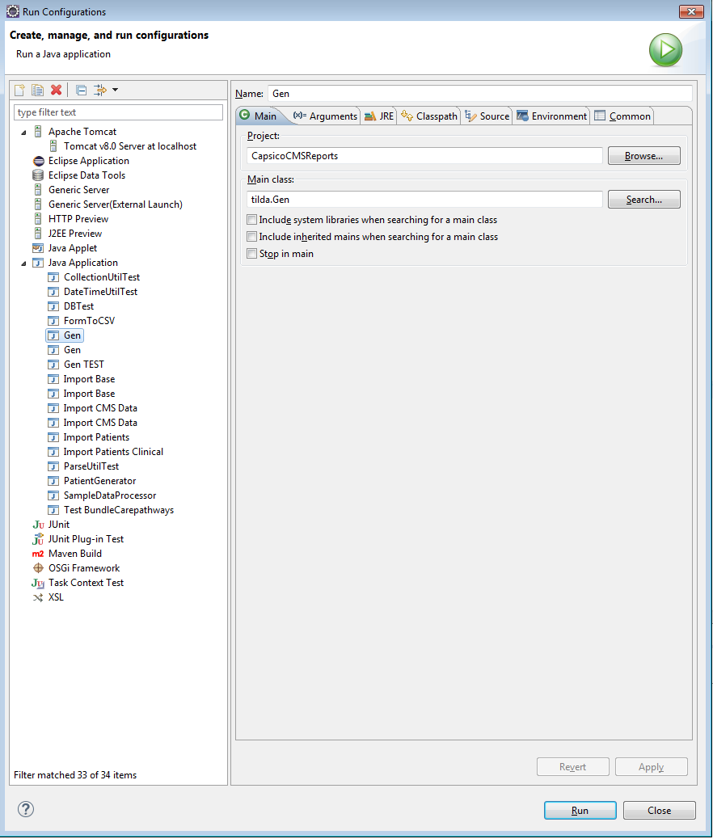
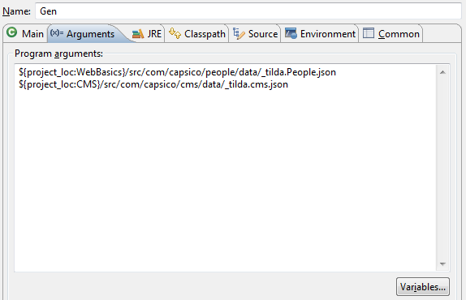
The Gen utility
Responsible for taking the json schema definition and generating code artifacts.
The class is “tilde.Gen”
The utility takes in a list of Tilda JSON files to process
For example, in Eclipse, the run configuration would look as follows
In this tutorial, we’ll also use the WebBasics project and generate the People schema

Slide 8
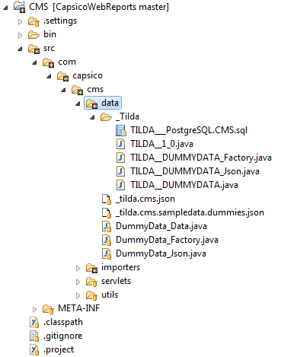
Tilda generated artifacts
Internal files generated in the _Tilda package
Never touch anything in the _Tilda package! The Gen utility deletes and replaces all files there every time
A generated package with internal assets
A generated DDL file for internal use
A generated internal class with common code
Generated internal classes for
Factory: Create/Lookup functionality
Data: getter/setter/read/write functionality
JSON: json serialization
Application-level classes (which you can modify) to extend base Factory, Data and Json capabilities from the internal base classes.
These classes are generated once the first time. It is then your responsibility to maintain it when needed.
Note that everything in the generated _Tilda folder is considered a build artifact and is generally not included in your repository
Typically you’d have the following in your .gitignore file
/src/com/capsico/cms/data/_Tilda
There are additional HTML documentation files in the _Tilda folder

Slide 9
Basic programming model
Three main classes: Factory, Data ands Json
Simple setup of create/set/write or lookup/set/read
String patientId = "1234567";
String diseaseName = "HF";
String state = "TX";
float cost = 1000;
ZonedDateTime dateOfService = ZonedDateTime.now();
DummyData_Data Dummy = DummyData_Factory.Create(patientId, diseaseName, state, cost, dateOfService);
Dummy.setDescr("blah blah blah");
if (Dummy.Write(C) == false)
throw new Exception("Cannot create a new Dummy record");
long refnum = Dummy.getRefnum();
Dummy = DummyData_Factory.LookupByPrimaryKey(refnum);
if (Dummy.Read(C) == false)
throw new Exception("Cannot read the just created Dummy record");
ListResults<DummyData_Data> Dummies = DummyData_Factory.LookupWhereDiseaseState(C, diseaseName, state, 0, 250);
PrintWriter Out = new PrintWriter(System.out);
for (DummyData_Data d : Dummies)
DummyData_Json.toJSON(Out, d, true);
Create method generated with all “nullable”:false columns
You can set additional columns
You write to the DB, and check for errors (non fatal errors such as index or PK violations return false, whereas serious errors such as connectivity or database corruptions throw exceptions)
Lookup an object by primary key
You read from the DB, and check for errors (i.e., if an object was returned or not).
Lookup a list of objects against the index, starting at row 0, up to 250 records. If no row were found, an empty list is returned.
ListResults extends java.util.List but adds support for paging by keeping track of start (here 0), the number of records pulled, and whether more exist in the DB

Slide 10
Anatomy of the internal _Factory class
public class TILDA__DUMMYDATA_Factory
{
protected TILDA__DUMMYDATA_Factory() { }
// The table name associated with this object
public static final String TABLENAME;
// Column definitions (only usable from derived app-level Factory class)
protected static abstract class COLS {
public static Type_LongPrimitive REFNUM ;
public static Type_StringPrimitive PATIENTID ;
public static Type_StringPrimitive DISEASENAME ;
public static Type_StringPrimitive STATE ;
public static Type_FloatPrimitive COST ;
public static Type_StringPrimitive DATEOFSERVICETZ;
public static Type_DatetimePrimitive DATEOFSERVICE ;
public static Type_StringPrimitiveNull DESCR ;
public static Type_DatetimePrimitive CREATED ;
public static Type_DatetimePrimitive LASTUPDATED ;
public static Type_DatetimePrimitiveNull DELETED ;
}
// Query helpers for this object (only usable from derived app-level Factory class)
protected static SelectQuery newSelectQuery(Connection C);
protected static SelectQuery newWhereQuery ( );
protected static UpdateQuery newUpdateQuery(Connection C);
protected static DeleteQuery newDeleteQuery(Connection C);
// Method to run arbitrary query on this object (only usable from derived app-level Factory class)
protected static ListResults<com.capsico.cms.data.DummyData_Data> runSelect(Connection C, SelectQuery Q, int Start, int Size);
// Create method, with “not null” columns
static public com.capsico.cms.data.DummyData_Data Create(String patientId, String diseaseName, String state, float cost, ZonedDateTime dateOfService);
// Lookup by primary key
static public com.capsico.cms.data.DummyData_Data LookupByPrimaryKey(long refnum);
// LookupWhereXXX for each declared index
static public ListResults<com.capsico.cms.data.DummyData_Data> LookupWhereDiseaseState(Connection C, String diseaseName, String state, int Start, int Size);
}

Slide 11
Anatomy of the app-level _Factory class
// This class inherits from the internal Tilda-generated Factory class.
// This class is where app-level customizations go
public class DummyData_Factory extends com.capsico.cms.data._Tilda.TILDA__DUMMYDATA_Factory
{
protected static final Logger LOG = LogManager.getLogger(DummyData_Factory.class.getName());
protected DummyData_Factory() { }
/////////////////////////////////////////////////////////////////////////////////////////////////////////////////////////
/////////////////////////////////////////////////////////////////////////////////////////////////////////////////////////
// Implement your customizations, if any, below.
/////////////////////////////////////////////////////////////////////////////////////////////////////////////////////////
// init method called at system startup to do any “global” work for thie class (such as
// caching for example, or preparing other work)
public static void init(Connection C);
}

Slide 12
Anatomy of the internal _Data class
public abstract class TILDA__DUMMYDATA implements tilda.interfaces.WriterObject, tilda.interfaces.OCCObject, tilda.interfaces.JSONable
{
// You can only get an instance through the factory
protected TILDA__DUMMYDATA();
// Check if an object has changed (i.e., one or more field has been set with a new value)
public boolean hasChanged ();
// Check if an object was just created, but not yet been written to the DB
public boolean isNewlyCreated();
// Each field has a getter and a setter, and a way to test if the field has changed since it was last read from the DB
// Columns could be defined as INVARIANT, and as such, wouldn’t have any setters (i.e., they can only be set as part of tha factory’s create)
public final String getPatientId()
public void setPatientId(String v) throws Exception
public boolean hasChangedPatientId ()
// Nullable fields have additional support for NULL operations
public final String getDescr()
public final boolean isNullDescr()
public void setDescr(String v) throws Exception
public void setNullDescr()
public boolean hasChangedDescr()
// Copied all fields except PK and INVARIANTs to another object
public void CopyTo(com.capsico.cms.data._Tilda.TILDA__DUMMYDATA Dst) throws Exception
// Writes the object to the DB
public final boolean Write(Connection C) throws Exception
// Reads an object from the DB
public final boolean Read(Connection C) throws Exception
// Touches the row in the DB with a new value for “lastUpdated”
public final boolean Touch(Connection C) throws Exception
// rereads the object from the DB, for example, to update fields with DB-generated columns through triggers or other such things.
public final boolean Refresh(Connection C) throws Exception
// For debugging purpose, prints out all the field values for this object
public String toString()
// Export this object to JSON
public void toJSON(Writer Out, String JsonExportName, boolean FullObject) throws Exception
}

Slide 13
Anatomy of the app-level _Data class
// This class inherits from the internal Tilda-generated Data class.
// This class is where app-level customizations go
public class DummyData_Data extends com.capsico.cms.data._Tilda.TILDA__DUMMYDATA
{
protected static final Logger LOG = LogManager.getLogger(DummyData_Data.class.getName());
public DummyData_Data() { }
/////////////////////////////////////////////////////////////////////////////////////////////////////////////////////////
/////////////////////////////////////////////////////////////////////////////////////////////////////////////////////////
// Implement your customizations, if any, below.
/////////////////////////////////////////////////////////////////////////////////////////////////////////////////////////
// Method called before the internal Data class’ Write() method is called.
@Override
protected boolean BeforeWrite(Connection C) throws Exception
{
// Do things before writing the object to disk, for example, take care of AUTO fields.
return true;
}
// Method called after the internal Data class’ Read() method is called.
@Override
protected boolean AfterRead(Connection C) throws Exception
{
// Do things after an object has just been read form the data store, for example, take care of AUTO fields.
return true;
}
}

Slide 14
Anatomy of the internal _Json class
public class TILDA__DUMMYDATA_Json
{
// Tilda uses the GSON library for JSON processing
/*@formatter:off*/
@SerializedName("patientId" ) public String _patientId ;
@SerializedName("diseaseName" ) public String _diseaseName ;
@SerializedName("state" ) public String _state ;
@SerializedName("cost" ) public Float _cost ;
@SerializedName("dateOfService" ) public String Str_dateOfService;
transient public ZonedDateTime _dateOfService ;
@SerializedName("descr" ) public String _descr ;
/*@formatter:on*/
// After having been loaded as JSON, write the object to the DB
// This method automatically handles duplicates (via PK or unique index) and will update a row if necessary
public com.capsico.cms.data.DummyData_Data Write(Connection C) throws Exception
// Debugging help to validate what was read from a JSON input
public String toString()
// Takes a Data instance and writes it as JSON
public static void toJSON(Writer Out, com.capsico.cms.data.DummyData_Data ObjApp, boolean FullObject) throws IOException
// Takes a list of Data instance and writes it as a JSON array
public static void toJSON(Writer Out, List<com.capsico.cms.data.DummyData_Data> L, String Lead, boolean FullList) throws IOException
}

Slide 15
Anatomy of the app-level _Json class
// This class inherits from the internal Tilda-generated Json class.
// This class is where app-level customizations go
public class DummyData_Json extends com.capsico.cms.data._Tilda.TILDA__DUMMYDATA_Json
{
protected DummyData_Json()
/////////////////////////////////////////////////////////////////////////////////////////////////////////////////////////
/////////////////////////////////////////////////////////////////////////////////////////////////////////////////////////
// Implement your customizations, if any, below.
/////////////////////////////////////////////////////////////////////////////////////////////////////////////////////////
}

Slide 16
Important Notes
Tilda has been designed to make evolving DB schemas and application logic simple. Many aspects of the framework support a very agile development cycle
Tilda generates compile-time artifacts, which means that changes to the data model in the JSON definition file result in changes in the generated code, which in turn can affect your own code that uses those APIs
Not-null fields translate into parameters in the Create method
Each field results in getters, setters and accompanying methods
Primary key, foreign key and index definitions result in Lookup methods with explicit parameters
Tilda has built-in automatic migration for many changes which kicks in when the application stars
Adding a new column
Changing the nullability of a column
Changing the type of a column
Adding new tables or views
All of this support activities that modify the underlying data model, and uses the compiler to flag errors in the code, which can then be cleaned out.

Slide 17
View Realization
Most databases have a View Materialization capabilities.
However, there are limitations. Complex views may result in materialization that is not easily updated, i.e., one change in the source data requires re-materializing everything. This is not scalable. The key issue is that the database doesn’t have a lot of meta-information about your data model.
Tilda does. So we have created something called Realization which works similarly but hopefully is smarter and faster, including defining PKs, FKs, and indices on an actual table.
X_View
X_Realized
realize - refill_X_Realized()

Slide 18
A_View
B_View
C_View
D_View
X_View
realize - refill_X_Realized()
X_Realized
Select x1, x2, x3 from X_View, left join T…
-> Select x1, x2, x3 from X_Realized, left join T…
Y_View
Y_View_R
Select x1, x2, x3, y1, y2, y3 from Y_View, left join T2…
-> Select x1, x2, x3, y1, y2, y3 from Y_View_R, left join T2…
Z_View
realize - refill_Z_Realized()
Z_Realized

Slide 19
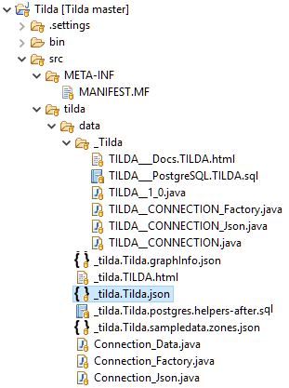
Tilda Artifacts
A Manifest with Tilda directives
_tilda.Tilda.json
A generated package with internal assets
HTML Documentation
tilda.Gen
A generated DDL file for internal use
A generated internal class with common code
Generated internal classes for
Factory: Create/Lookup functionality
Data: getter/setter/read/write functionality
JSON: json/csv and other format serialization
Source Model Definition
Additional DDL
Meta-data file for ER Diagraming tool
Sample json-based data
Application-level classes (which you can modify) to extend base Factory, Data and Json capabilities from the internal base classes.
These classes are generated once the first time. It is then your responsibility to maintain it when needed.

